Slide 1

RAJASTHAN INSTITUTE OF ENGINEERING AND TECHNOLOGY, JAIPUR
DEPARTMENT OF COMPUTER SCIENCE AND ENGINEERING
PROJECT : SMART HOME AUTOMATION
SUBMITTED TO
Dr. Saroj Hiranwal
SUBMITTED BY
Vicky Kumar 18ERECS080
Ankit Malpani 18ERECS009
Anil Puri Goswami 18ERECS008
Vritika Jangir 18ERECS089

Slide 2

SMART HOME AUTOMATION
Final Year Project

Slide 3
CONTENT
Introduction
What is Home Automation?
About
Component Used
Technologies Used
Android
Bluetooth Module
Why prefer Bluetooth?
Arduino and It’s Features
Relay
Circuit and Block Diagram
Screenshots
Advantages
Disadvantages
Application
Conclusion
References

Slide 4
INTRODUCTION
There is an increasing demand for smart homes, where appliances react automatically to changing environmental conditions and can be easily controlled through one common device.
This paper presents a possible solution whereby the user controls devices by employing a central Field Programmable Gate Array (FPGA), where control is communicated to the FPGA from a mobile phone through its Bluetooth interface.

Slide 5
WHAT IS HOME AUTOMATION?
A technique to use computer / smartphone and Information Technology in controlling Home appliances and Home features is called Home Automation.
It is automation of the:
Home
Housework or,
Household activity.
Home automation may include centralized control:
Lighting of entire house
HVAC (heating, ventilation and air conditioning)

Slide 6
About
This wireless technology is especially useful in home environment, where there exists hardly any infrastructure to interconnect intelligent appliances.
It could be suitably used for home automation in a cost-effective manner.
Operating over unlicensed, universally available frequency of 2.4 GHz, it can link digital devices within a range of 10 m (expandable to 100 m, by increasing the transmitted power) at the speed of 1 Mbps.
Building upon this theme; we propose a home automation system based on Bluetooth technology. The overall system should be fast enough to realize the true power of wireless technology.

Slide 7
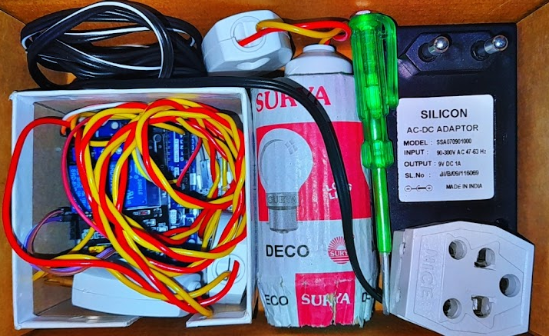
Components Used
MicroController ATMEGA8
Relay ( 2 pcs_6V/1A)
Adapter
Bluetooth Device HC_05
Bulb as load( 2 pcs_60W)
Android Mobile
Jumper Wires

Slide 8
Technologies Used
Flask Framework (Python Language)
Javascript (for Backend)
Java and XML (for Android App)
HTML, CSS, Bootstrap (for Frontend)
Embedded C Language (on Arduino IDE)
Firebase (as Database)

Slide 9
Working
It uses M-8870 DTMF (Dual Tone Multi Frequency) decoder IC which decodes tone generated by the keypad of cell phone.
Data is transmitted as pairs of tones.
DTMF signal can be tapped directly from the microphone pin of cell phone device.

Slide 10
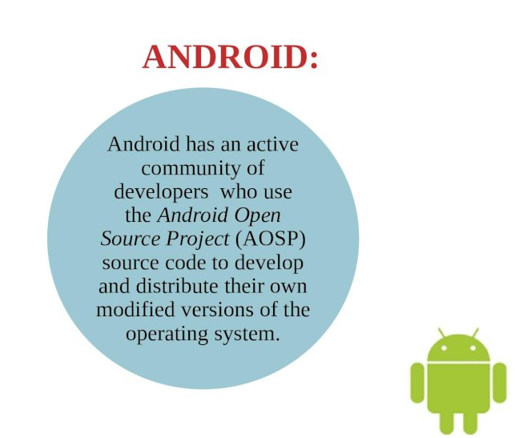

Slide 11
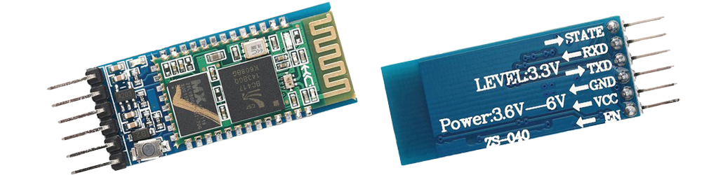
Bluetooth Module
HC-05 is a Bluetooth Smart module targeted for low-power sensors and accessories.
It integrates all features required for a Bluetooth Smart application.
It is powered directly from a standard 3V coin cell battery or a pair of AAA batteries.
In the lowest power sleep mode it merely consumes 500 nA and will wake up within a few hundred microseconds.
4 Pins (VCC, GND, RX, TX)

Slide 12
Why prefer Bluetooth?
It is preferable to use Bluetooth because nowadays people have their smartphones with them all the time, since the smart phones have Bluetooth facility in them, thus it's better to use Bluetooth rather than using IR remotes.
It's secure and Easy to use.
It works in short distance range (upto 10 mtrs.)
Anyone can find free Bluetooth apps on android.

Slide 13
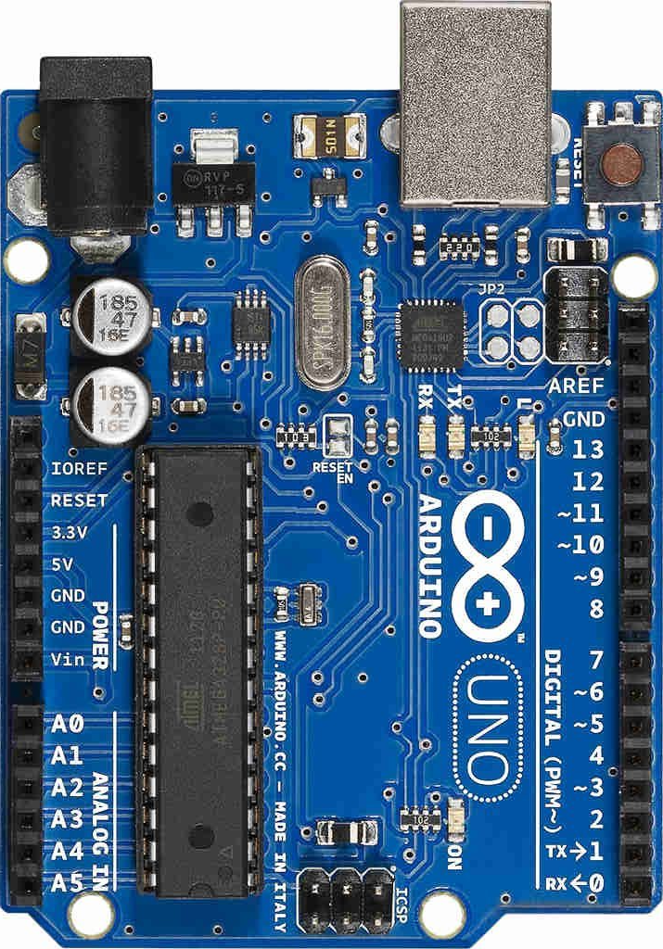
ARDUINO MicroController ATMEGA8
Arduino is an open-source hardware and software company, project and user community that designs and manufactures single-board microcontrollers and microcontroller kits for building digital devices.
Its hardware products are licensed under a CC-BY-SA license, while software is licensed under the GNU Lesser General Public License (LGPL) or the GNU General Public License (GPL), permitting the manufacture of Arduino boards and software distribution by anyone.

Slide 14
Features of Arduino
Microcontroller: ATmega328.
Operating Voltage: 5V.
Input Voltage (recommended): 7-12V.
Input Voltage (limits): 6-20V.
Digital I/O Pins: 14 (of which 6 provide PWM output)
Analog Input Pins: 6.
DC Current per I/O Pin: 40 mA.
DC Current for 3.3V Pin: 50 mA.

Slide 15
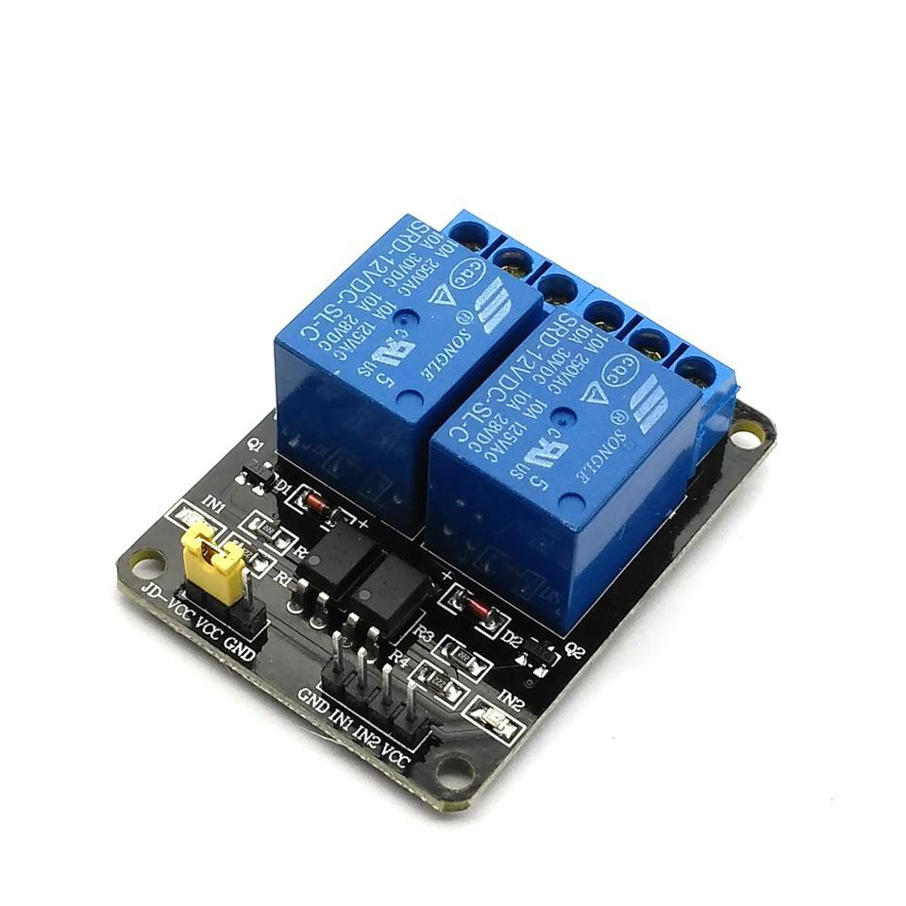
Relay
A Relay is an electrically operated switch.
Relays are used where it is necessary to control a circuit by a low-power signal.
Relays protect electrical circuits from overload or faults.
Rating: 6V/1A

Slide 16
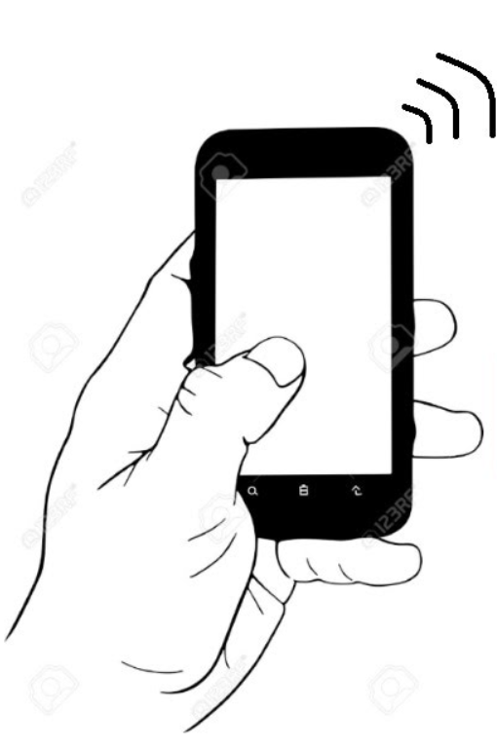
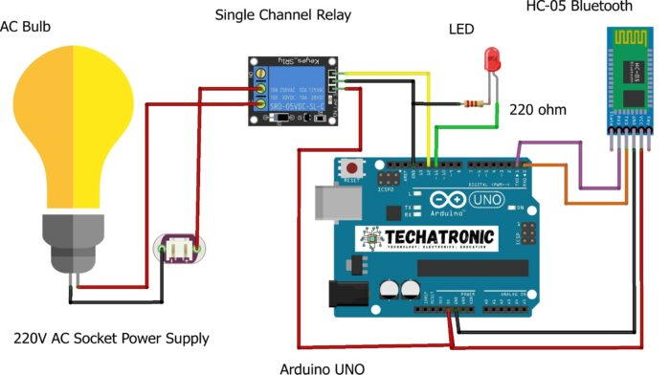
Circuit Diagram

Slide 17
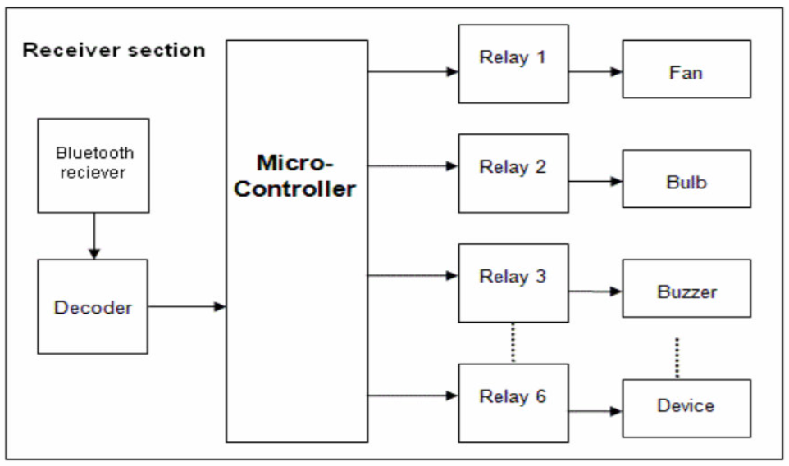
Block Diagram

Slide 18
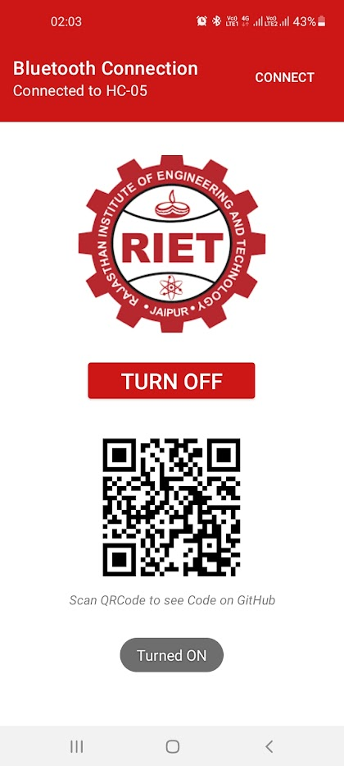
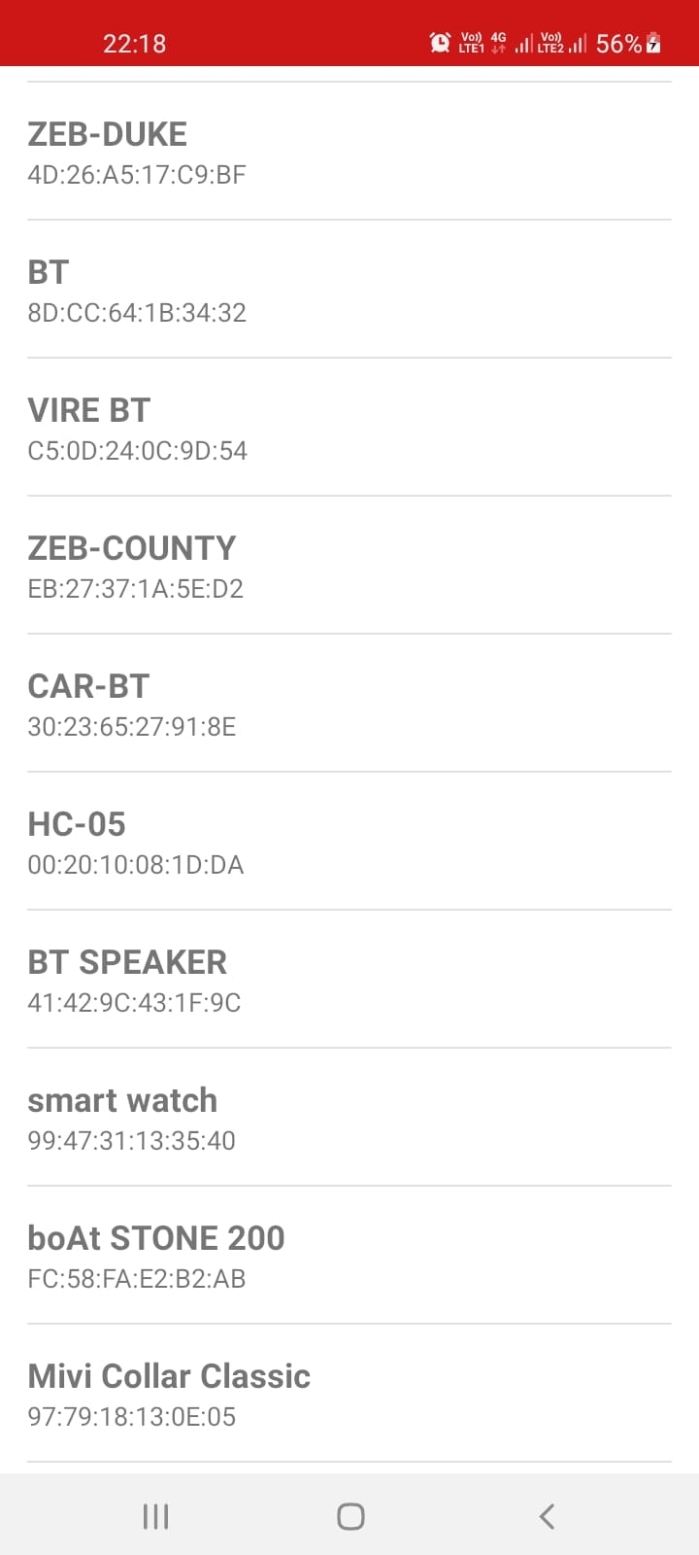
Screenshots

Slide 19
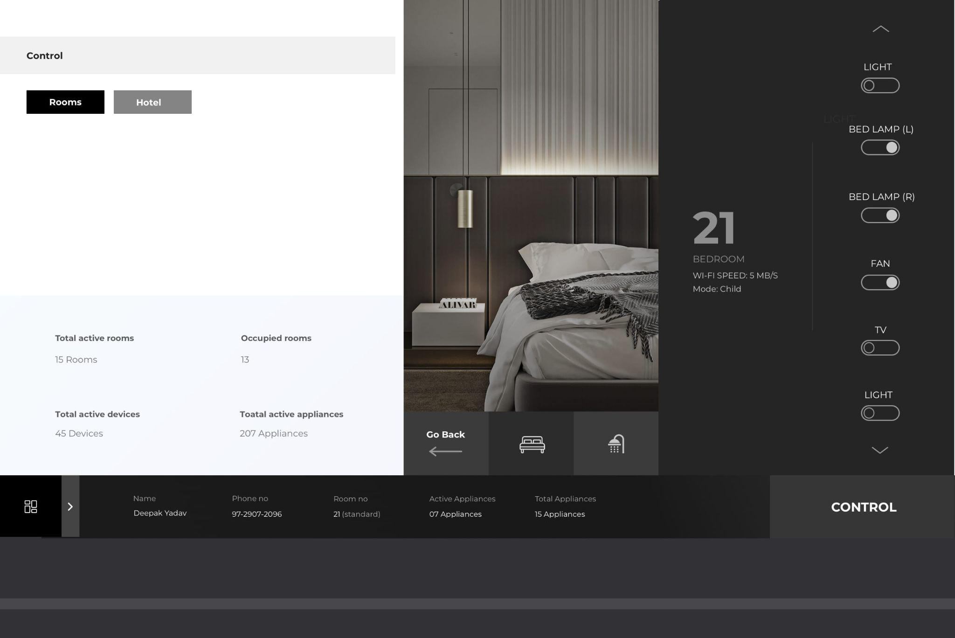
Smart
Home
Automation

Slide 20
Advantages
The main advantage of Home Automation through Android Mobile is that the Physically Challenged and Disabled People.
Controlled through one common device.
Fast enough to realize the true power of wireless technology.
Replace television, air conditioner etc., remotes for sleep mode.

Slide 21
Disadvantages
It can be used in a limited area (30 ft = 9.14 m).
It is too expensive.
It can not repair easily.

Slide 22
Software Design
Android uses Bionic in place of a standard C library, originally developed by Google specifically for Android, as a derivation of the BSD's standard C library code.
BSD Bionic has several major features specific to the Linux kernel, and its development continues independently of other Android's source code bases.
The main benefits of using Bionic instead of the GNU C Library (glibc) are its different licensing model, smaller runtime footprint, and optimization for low-frequency CPUs.

Slide 23
Application
Yet there is an increasing demand for smart homes, where controlled through one common device. This wireless technology is especially useful in home environment.
Lights and appliances (direct, powerline or wireless)
TV, VCR, DVD, Tivo (IR)
Monitor weather
Temperature
Thermostats
Internet Information

Slide 24
Conclusion
Prime objective is to assist handicapped / old aged people.
This project is based on Android & Arduino platform both of which are FOSS (Free Open Source Software).
The design consists of Android phone with home automation devices.

Slide 25
References
https://www.slideshare.net/JKartik1/bluetooth-based-home-automation/
https://slideplayer.com/slide/6034640/
https://fdocuments.in/document/android-based-home-automation.html
https://www.scribd.com/doc/85220856/Home-Automation-Ppt-Modified-2
https://mysteriousmaniacs.weebly.com/uploads/1/2/5/6/12565748/home_automation.pdf
https://cupdf.com/document/presentation-on-home-automation.html

Slide 26


